Slide 1

Becoming a Force for Good
Module 3
Power of Habits
Notes:
INSTRUCTOR NOTES:
Print the notes page view of this presentation for reference during the class session
Present the PowerPoint slides via a projector or monitor to students using SLIDE SHOW viewing mode

Slide 2
Becoming a Force for Good
Mission & Objectives
TEACHER
Mission
Building champions for social justice
Objectives
Reinforce the importance of diversity
Identify actions that may lead to injustice
Challenge students to stand for justice
Encourage the adoption of habits that support social justice
Notes:
Charts that have the TEACHER INDICATOR in the upper left corner are not intended for student viewing (Teacher discretion)

Slide 3
AGENDA
TEACHER
Module 3 Charts
Table Top exercise 4 - 7
Mindbugs 8 -10
The Power of Habits 11-15
Scorecard check up 16
Reflection 17
Notes:
Charts that have the TEACHER INDICATOR in the upper left corner are not intended for student viewing (Teacher discretion)

Slide 4
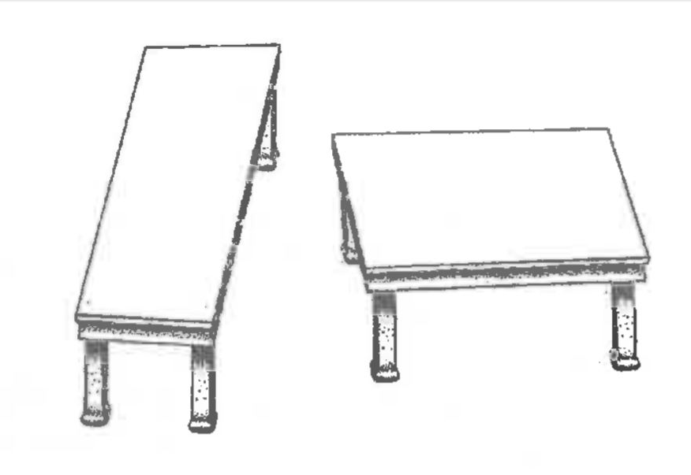
Compare Two Tables
ACTIVITY
Which table is:
  Longer? ____
  Wider? ____
Table AA
Table BA
Notes:
INSTRUCTOR NOTES:
The table top exercise provides students a hands-on opportunity to learn that things are not always as they appear to be
The following three charts will illustrate that the table tops of Table A and Table B are the same size, even though they do not appear to be.
START by asking the class which of the 2 table tops on Chart 4 is:
LONGER?
WIDER?

Slide 5
Lay Parallelogram over tables
ACTIVITY
Parallelogram
Table AA
Table BA
Notes:
INSTRUCTOR NOTES:
What happens when we overlay the parallelogram outlined in red on the left over both Table A and Table B?

Slide 6
Table Top Match
ACTIVITY
Parallelogram
Table AA
Table BA
Matches Table A
Notes:
INSTRUCTOR NOTES:
We see that the Parallelogram matches Table A
But what about Table B?

Slide 7
Things are not always as they appear
ACTIVITY
Parallelogram
Table AA
Table BA
Matches Table B
Notes:
INSTRUCTOR NOTES:
Now we find that when the parallelogram is overlaid on Table B- it matches as well.
This is because the 3D aspect of the table top tricks our brains into seeing the two table tops as different sizes, even when they are the same!

Slide 8
Mindbugs
TEACHER
ACTIVITY
Mindbugs are defined as follows:
“Ingrained habits of thought that lead to errors in how we perceive, remember, reason and make decisions.”
Social mindbugs are about how we make decisions about people. They “can give us both false feelings of faith in people we perhaps shouldn’t trust and the opposite – feelings of distrust towards those whom we perhaps should trust” – all because of the social group to which they belong (or to which we think they belong!).
Notes:
Charts that have the TEACHER INDICATOR in the upper left corner are not intended for student viewing (Teacher discretion)

Slide 9
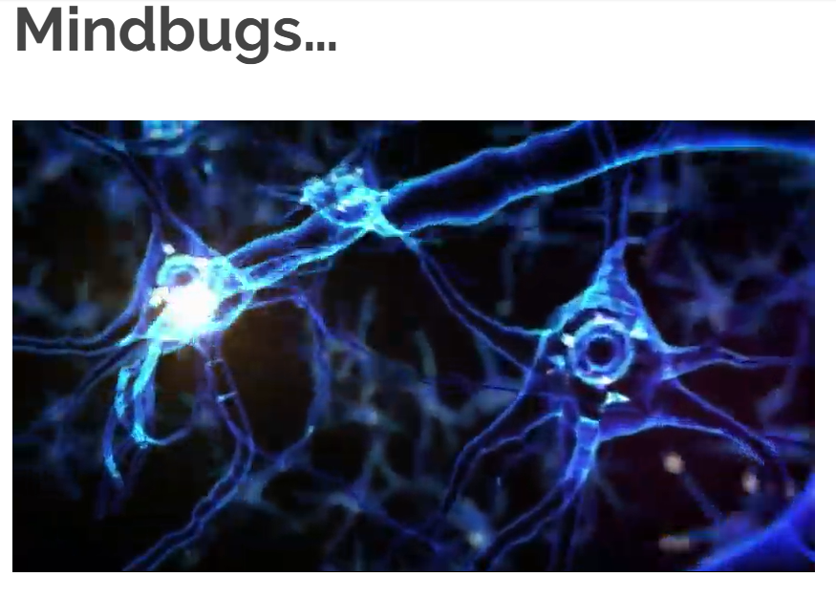
Source: Direction Europe
ACTIVITY
https://thekellyway.org/mindbugs/
Notes:
INSTRUCTOR NOTES:
Launch video from power point presentation mode by clicking on Mindbugs graphic
https://www.youtube.com/watch?v=3nJzZkpfwTc&feature=youtu.be
The table top exercise provides a good example of “mindbugs”
Discuss how this can apply to our view of other people as well- referred to as “social mindbugs”
We’ve all heard the saying “you can’t judge a book by its cover”, but this is exactly what mindbugs lead us to do

Slide 10
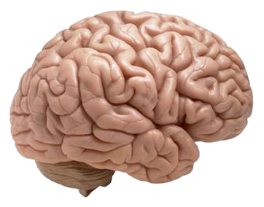
Our brains use habits to perform efficiently
Most of the choices we make each day may feel like the products of well-considered decision making, but they are not. They are habits which can be impacted by mindbugs.
A normal part of how our brains function is in developing habits, which serves to make some thing routine, lessening the amount of brain energy that is required to perform these actions.
Though each habit means relatively little on its own, over time, the meals we eat, what we say to others, how often we exercise, and the way we organize our thoughts and routines have enormous impact on how we live and who we are.
Habits are often good, but some habits may have a negative impact on not only ourselves, but on others as well.
Notes:
INSTRUCTOR NOTES:
Emphasize that habits are necessary and when managed appropriately enable people to use their brains more effectively

Slide 11
The Power or Habit
  *2006 Duke University research, referenced in the New York Times bestseller book The Power of Habit, by Charles Duhigg,
Your net worth to the world is usually determined by what remains after your bad habits are subtracted from your good ones.
-Benjamin Franklin
“40% of the actions people perform each day weren’t actual decisions, but habits” *
Our character is basically a composite of our habits. Because they are consistent, often unconscious patterns, they constantly, daily, express our character.
-Stephen Covey
Good habits formed at youth make all the difference.
-Aristotle
Notes:
INSTRUCTOR NOTES:
Emphasize the insights shared regarding the power of habits in each person’s life

Slide 12
Habits Really Do Matter
40% of the actions people perform each day weren’t actual decisions, but habits
Notes:
INSTRUCTOR NOTES:
Remind the class of the previous discussion about the significant number of our daily actions are based on habit
The yellow triangles provide a visual aid of how significant 40% is to the total number of triangles on the slide
We spend a lot of our time in the “automatic pilot” mode

Slide 13
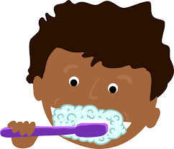
Group Discussion
Forming A New Habit
DISCUSS
You’ve chosen 5 new personal habits that you will need to work at making part of your everyday routine.
Creating a new habit requires that you repeat the desired actions over and over until the track in your brain is firmly established. It then becomes a normal part of your daily routine, just like brushing your teeth!
Discuss how you develop habits by making them a “routine”.
Notes:
INSTRUCTOR NOTES:
Its important that students feel comfortable in sharing their perspectives with the group. Make sure that everyone that wishes to speak is heard.

Slide 14
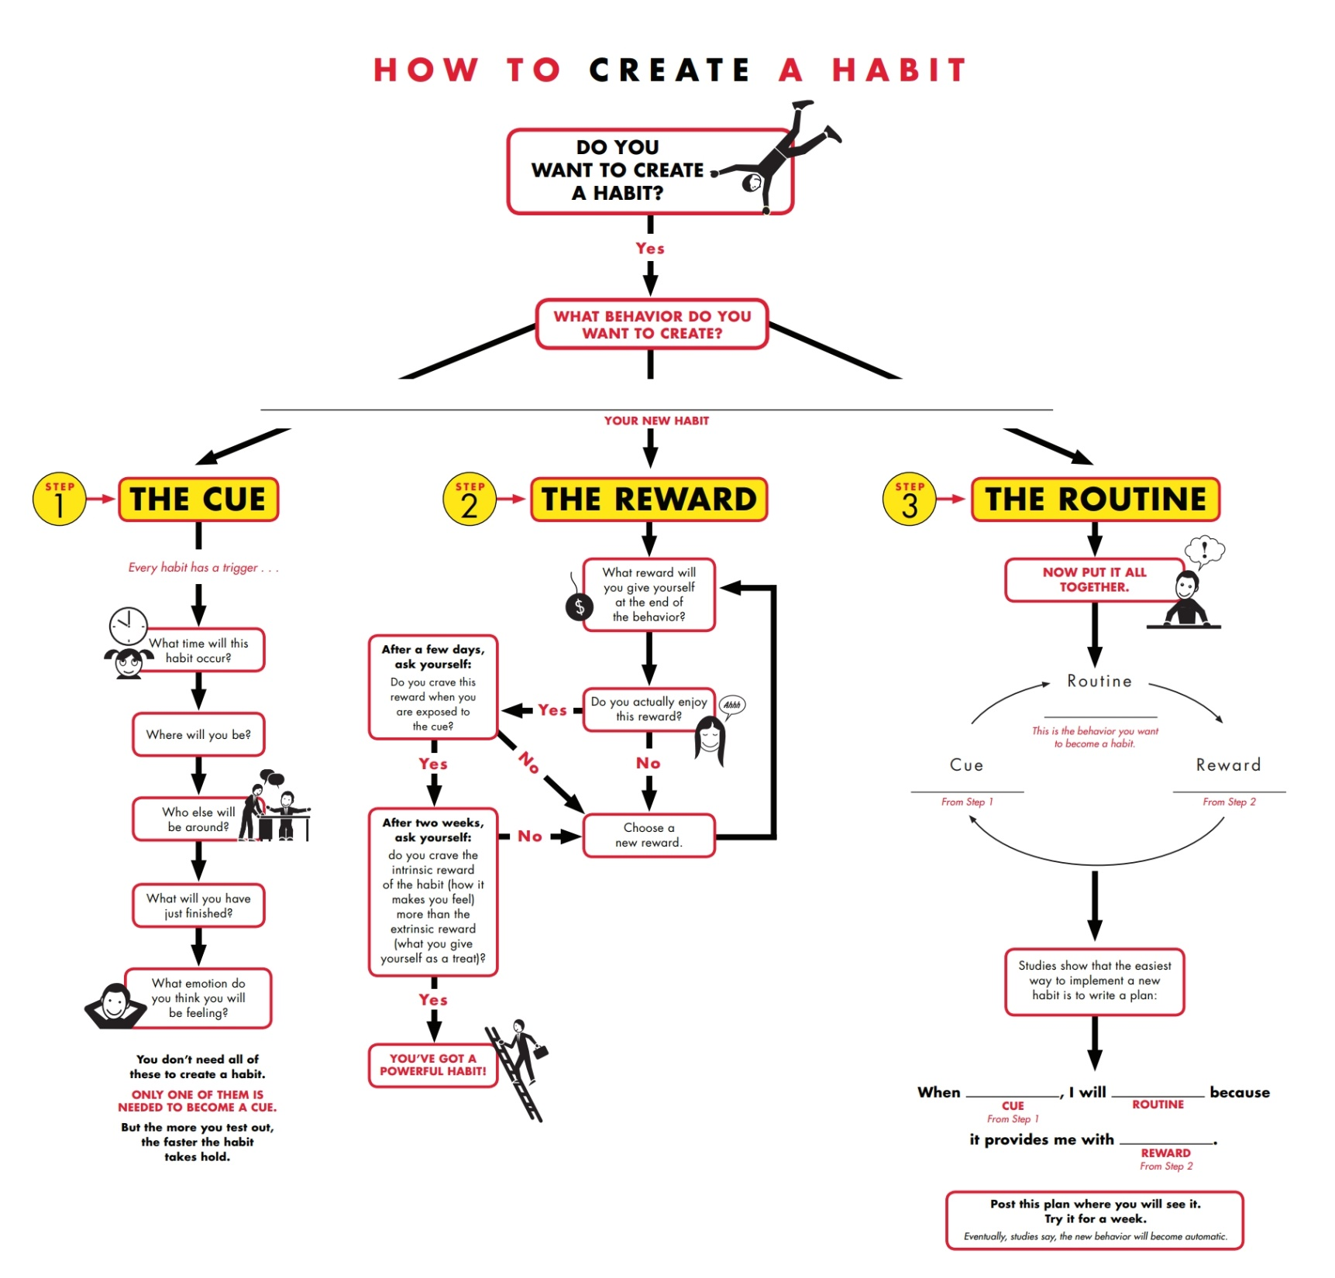
TEACHER
Notes:
Charts that have the TEACHER INDICATOR in the upper left corner are not intended for student viewing (Teacher discretion)
INSTRUCTOR NOTES:
While the “How to Create a Habit” flow diagram may appear detailed, the teacher may choose to walk through the Cue/Reward/Routine process to assist students as they think
about creating new habits.

Slide 15

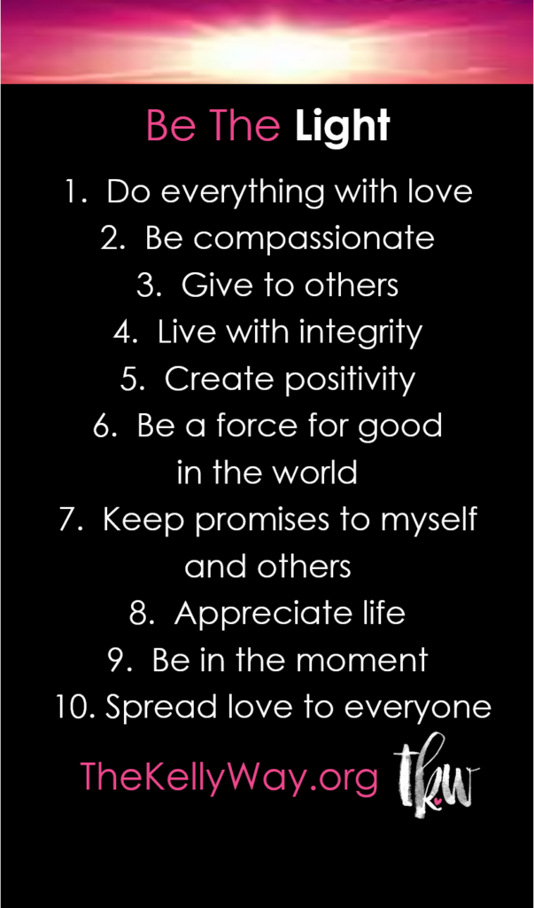
Brainstorm
How habits can help in standing against injustice
DISCUSS
Notes:
INSTRUCTOR NOTES:
Lead the group in a discussion about how the positive habits identified by the group on slide 10, along with Kelly’s Be the Light habits, can help someone take a stand against injustice
Ask students to start thinking about creating a list of 5 habits that will help them to stand against injustice
Inform students that the next session will provide the opportunity for each student to develop their own list of 5 habits

Slide 16
Update Your Scorecard Daily
Notes:
INSTRUCTOR NOTES:
Ask students how they are progressing with daily scorecard updates
Which habits come easy (1 ratings)
Which habits are more difficult (3 ratings)
Encourage students to update scorecards which is key to developing new habits

Slide 17
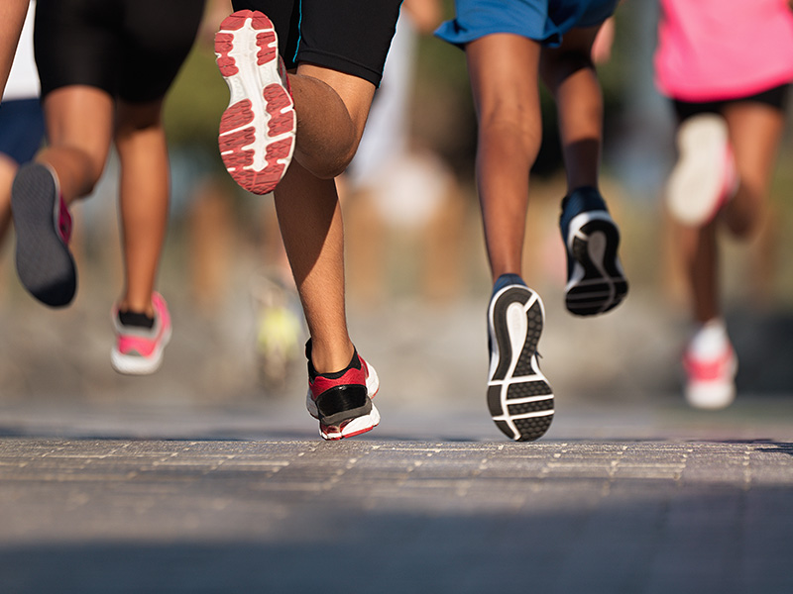
Reflection
Review your scorecard and select a habit to focus on improving
Use the How to Create a Habit flowchart for the steps to make the habit a part of your routine
Continue to track your habits daily on your scorecard
Notes:
INSTRUCTOR NOTES:
Distribute Stop Injustice magnets to each student
Encourage students to talk about the things they’ve learned and discussed at home

