Slide 1
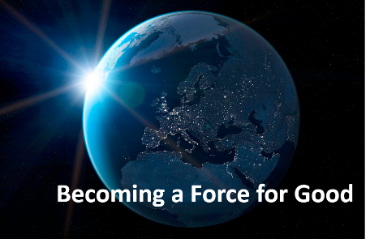
Becoming a Force for Good
Module 5
Be Inclusive
Notes:
INSTRUCTOR NOTES:
Print the notes page view of this presentation for reference during the class session
Present the PowerPoint slides via a projector or monitor to students using SLIDE SHOW viewing mode

Slide 2
Becoming a Force for Good
Mission & Objectives
TEACHER
Mission
Building champions for social justice
Objectives
Reinforce the importance of diversity
Identify actions that may lead to injustice
Challenge students to stand for justice
Encourage the adoption of habits that support social justice
Notes:
Charts that have the TEACHER INDICATOR in the upper left corner are not intended for student viewing (Teacher discretion)

Slide 3
AGENDA
TEACHER
Module 5 Charts
Step Up Activity 4 - 8
Being left out – group discussion 9
Including others – a practical way of standing up for justice 10- 13
Habit postcard 14
Scorecard check-up 15
Reflection 16
Notes:
Charts that have the TEACHER INDICATOR in the upper left corner are not intended for student viewing (Teacher discretion)

Slide 4

Step Up!
ACTIVITY
Notes:
INSTRUCTOR NOTES:
Display this slide to the class during the Step Up! activity

Slide 5
Step Up!
TEACHER
ACTIVITY
The purpose of the Step Up activity is to help students gain an understanding of how others have been affected by teasing, bullying and exclusion.
The following three Teacher charts provide instruction on how to implement this activity in your classroom.
Notes:
Charts that have the TEACHER INDICATOR in the upper left corner are not intended for student viewing (Teacher discretion)

Slide 6
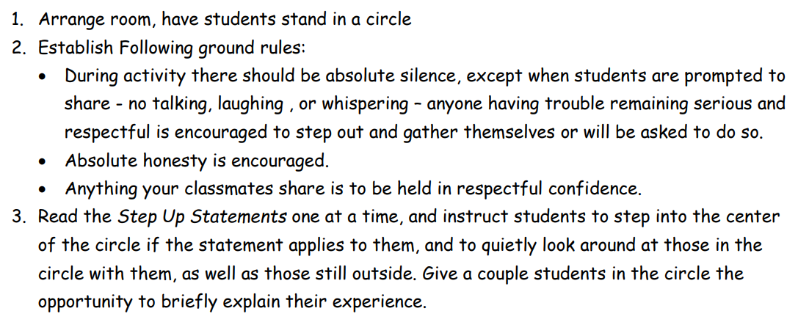
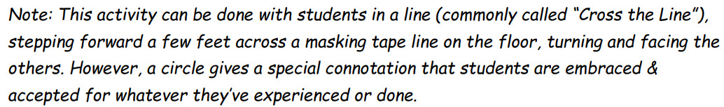
Step Up!
TEACHER
ACTIVITY
Select the Step Up Statements from the following chart that work best for your group. It may not be necessary to use a large number of statements.
Notes:
Charts that have the TEACHER INDICATOR in the upper left corner are not intended for student viewing (Teacher discretion)
Instructions in chart for teacher review

Slide 7
Step Up!
TEACHER
ACTIVITY
Step Up Statements
People routinely mispronounce your name
You have made fun of someone because of something about their appearance
You have been teased by someone because of the way you talk
You have purposely excluded someone from your group because of their appearance
You have been teased because of your race or skin color
You have been teased because of your culture or religion
You had an imaginary friend as a small child
You’ve ever had a friend share your secrets with someone else
You’ve had mean things said to or about you on a social media page or app
You have posted a mean statement about someone on social media or agreed with someone else’s mean statement
You’ve acted like something didn’t hurt your feelings or offend you, but it really did
You have made a mean statement about someone behind their back
You have seen someone getting picked on and didn’t stand up for them
You joined in teasing somebody because everyone was doing it
You spoke up to someone who was teasing or bullying someone else
You’ve experienced or witnessed someone being excluded, teased or bullied at school
You wish you would have stood up for someone in this room
You are friends or family with someone with some kind of disability
You went to see a movie in the past month
You are an only child
You didn’t step across the line, but you should have
You thought a classmate should’ve crossed the line but didn’t
Notes:
Charts that have the TEACHER INDICATOR in the upper left corner are not intended for student viewing (Teacher discretion)
INSTRUCTOR NOTES:
This list is a bit overwhelming and is offered up to provide a variety of examples of the type of questions that the facilitator might choose to ask.
It may take only a handful of questions to move all students forward into the circle.

Slide 8
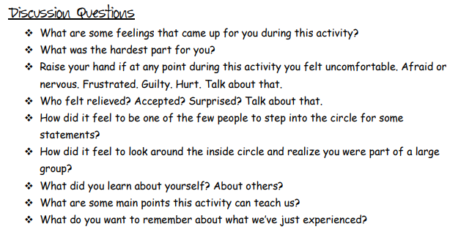
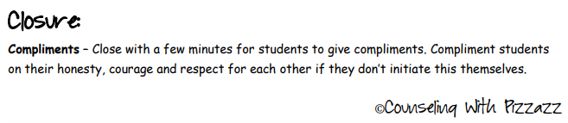
Step Up!
TEACHER
ACTIVITY
Notes:
Charts that have the TEACHER INDICATOR in the upper left corner are not intended for student viewing (Teacher discretion)

Slide 9
Group Discussion
How does being left out make someone feel?
DISCUSS
Sometimes injustice can cause great physical harm, but other times being treated unfairly can hurt someone really badly and no one else can see it.
How does it make you feel when you are left out by others?
How might someone feel when they participate in a group that is excluding another student or group of students?
How do you feel when someone ignores you when you are trying to talk to them? Do you catch yourself doing the same to others?
How might social media be used as a means of excluding others? What actions should be considered when you observe this taking place to someone else?
Notes:
INSTRUCTOR NOTES:
Reinforce key learnings through student discussion

Slide 10
VIDEO
Being Inclusive
video
Notes:
INSTRUCTOR NOTES:

Slide 11
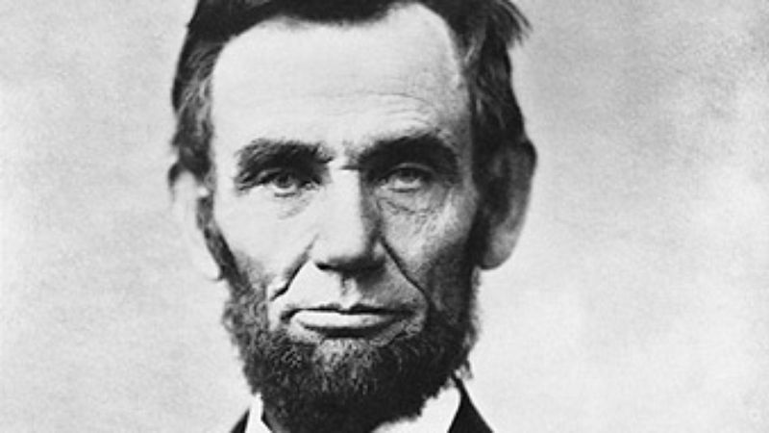
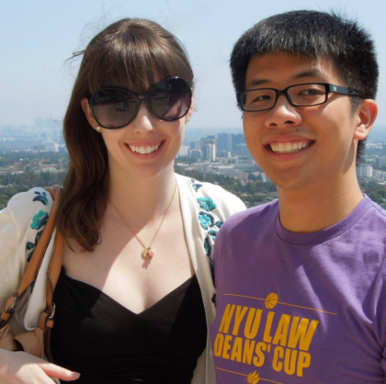
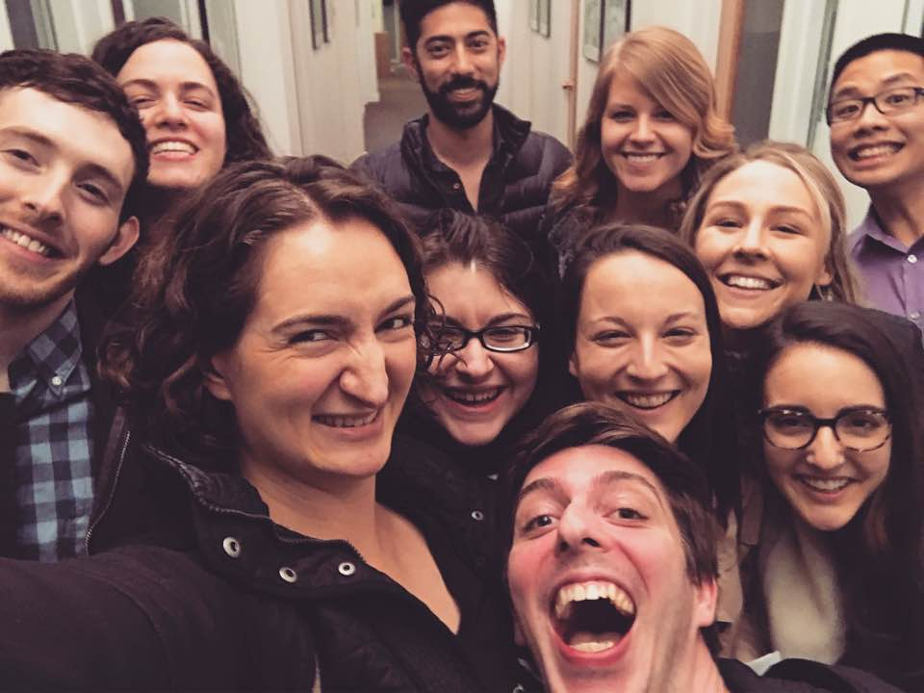
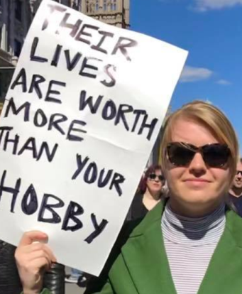
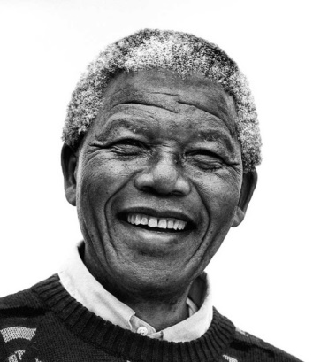
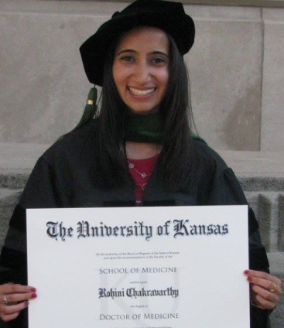
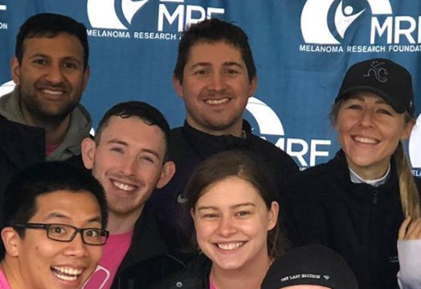
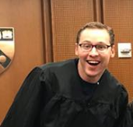
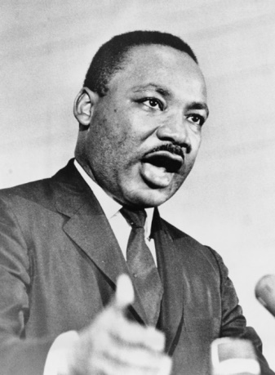
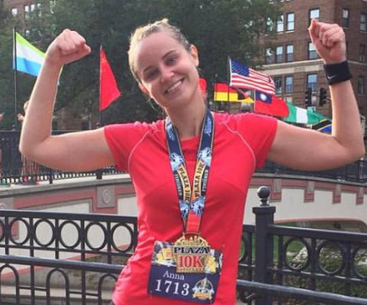
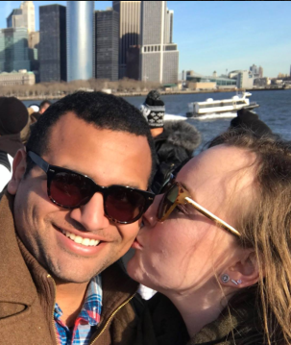
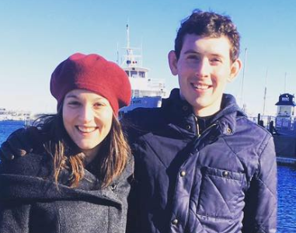
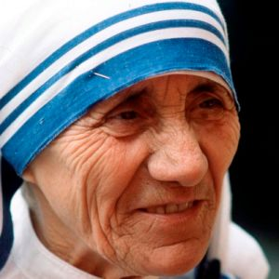

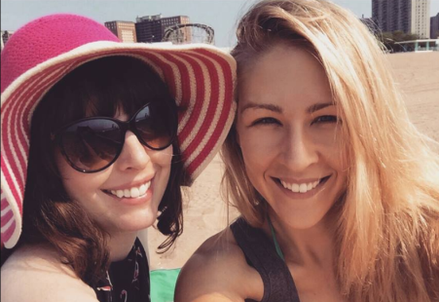
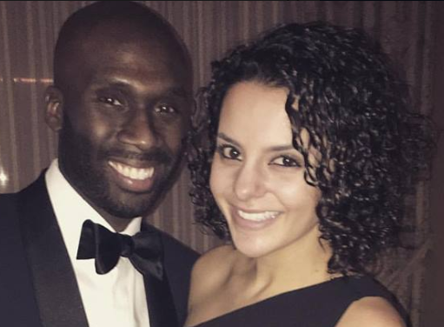
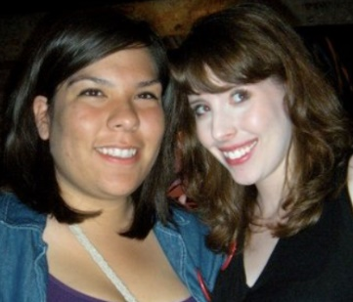
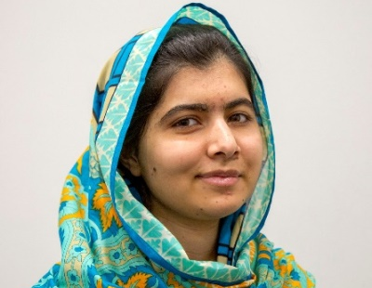
Champions for Social Justice Include Others
DISCUSS
https://thekellyway.org/be-the-light-blogs/
Notes:
INSTRUCTOR NOTES:
Reinforce that everyone has an important role to play when it comes to including others and not allowing someone to be treated poorly by being left out
The blog on the following two charts describes how someone who felt left out at times was made to feel like they counted
Additional blogs written about Kelly and the Be the Light Habits can be found at: https://thekellyway.org/be-the-light-blogs/

Slide 12

BLOG
_____________________________________________________________________________________________________________________________________________________________________________________________________________________________________________________________________________________________________________________________________________________________________________________________________________________________________________________________________________________________________________________________________________________________________________________________________________________________________________________________________________________________________________________
_____________________________________________________________________________________________________________________________________________________________________________________________________________________________________________________________________________________________________________________________________________________________________________________________________________________________________________________________________________________________________________________________________________________________________________________________________________________________________________________________________________________________________________________
_______________________________________________________________________________________________________________________________________________________________________________________________________________________________________
When I was younger, I was an opie-dopey little kid; many would suggest that I still am still opie-dopey, but that’s another story for another day. In my gawky youth, I got bullied; as many people know, middle school children are some of the worst people on the planet. (Disclaimer: Kelly would not approve of that sentence). As a kid, I got picked on for number of reasons, chief of which, I believe involved cooties. Looking back, it’s actually amazing how much grief this fictional ailment caused me, but that was okay, because like most kids going through my struggle, my parents gave me the cliché advice that “It’ll get better when you’re older.” So, I waited until I got older, hoping that one day, I’d find happiness, and people who accepted me. So, I spent my middle school years biding my time until high school and waiting for that promise to come true.
Fast forward to 2004. I enter high school. I didn’t know a lot of people going into high school, but one of the first to greet me was Kelly. To try to describe Kelly briefly, she’s essentially what you get when you combine Audrey Hepburn, Ruth Bader Ginsburg, and Ellen DeGeneres after she’s taken a couple shots of NyQuil (note: this reference to Nyquil is really less of a commentary on Kelly and more of a commentary on Ellen’s energy…I digress). Upon meeting Kelly, I actually had to ask somebody near me if she went to the same feeder school as me, because she just started talking to me like we had already been best friends for years. Kelly very possibly could have been my first friend in high school, and she was always there for me. If I needed a kind word, she gave it to me; If I needed a hug, she embraced me; if I needed a reality check…she was there for me. If you were trying to cast a “John Hughes Coming of Age Film,” and were looking for somebody to portray the high school best friend, Kelly Cosby is literally the image that comes to mind.
Give to Others
Excerpt from Blog by Brian Israel

Slide 13
BLOG
_____________________________________________________________________________________________________________________________________________________________________________________________________________________________________________________________________________________________________________________________________________________________________________________________________________________________________________________________________________________________________________________________________________________________________________________________________________________________________________________________________________________________________________________
_____________________________________________________________________________________________________________________________________________________________________________________________________________________________________________________________________________________________________________________________________________________________________________________________________________________________________________________________________________________________________________________________________________________________________________________________________________________________________________________________________________________________________________________
_____________________________________________________________________________
As high school went on, I started making friends and finally felt like I fit in in a way that I never really had before. Unfortunately, at that point, I had to go off to college. I attended Creighton University, and during my first year there, I honestly hated it. I wanted to transfer, and I wanted to leave; I felt like I was losing every single one of my friends back home, friends I had worked so hard to get. It’s hard to really articulate how a kid feels when they spend their middle school years feeling like an outsider, then four years feeling like somebody on the inside, and then feeling like that’s been torn from you. It sucks. I wanted to be with my friends. I had decided to transfer and had filled out applications to do so. Not long after, I got a phone call from Kelly inviting me to go to the KU/OU game in Oklahoma with her and a few other friends. I jumped at the chance (before I even realized these were front row tickets). This may not seem like the biggest deal now, but for me then, it was this act of kindness that convinced me it was okay to be away from my friends, and that I wouldn’t and wasn’t losing them. Kelly, in large part, is why I never transferred from Creighton, and in larger part is why I am where I am now.
That’s who Kelly was. For all I know, she may have not thought twice about that gameday in the fall of 2008, but to me, that changed my life. That’s kind of Kelly’s game though; she changed, and continues to change, lives without even thinking twice about it. Kelly gave me hope that I could get through college and confidence to stay at the institution that gave me the passion to serve others, leading to my year of service, my attendance at Notre Dame Law School, and ultimately making me the lawyer that I am today; Kelly gave me that.
Give to Others
Excerpt from Blog by Brian Israel

Slide 14
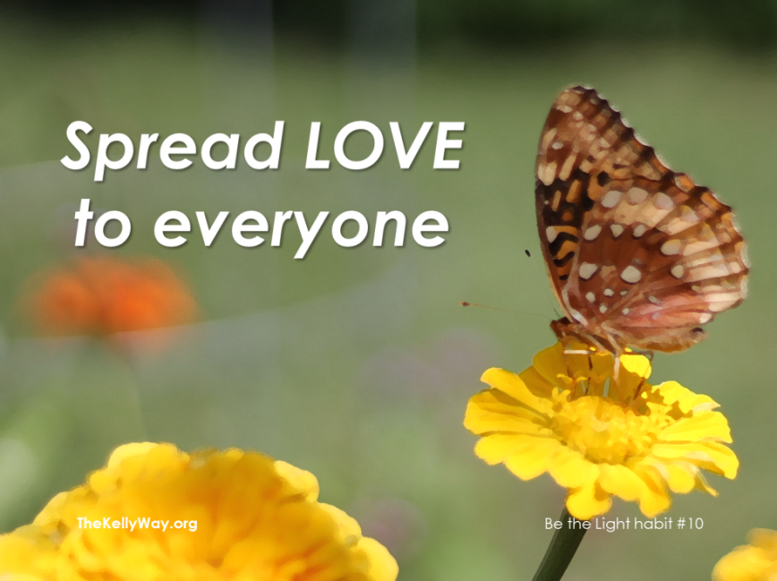
Highlighting one of your Habits
Create a postcard highlighting the one new habit that you find most challenging
  Postcard example (Kelly’s 10th habit)
Keep the postcard visible as you work on making this new habit part of your everyday life
Notes:
INSTRUCTOR NOTES:
Supplies required
Index cards or other paper
Markers
Other art supplies (optional)
Attempt to get 100% of class to create a postcard

Slide 15
Update Your Scorecard Daily
Notes:
INSTRUCTOR NOTES:
Ask students how they are progressing with daily scorecard updates
Which habits come easy (1 ratings)
Which habits are more difficult (3 ratings)
Encourage students to update scorecards which is key to developing new habits

Slide 16
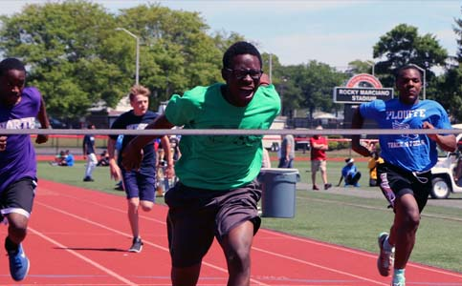
Reflection
Review
Use
Continue to track your habits daily on your scorecard
Notes:
INSTRUCTOR NOTES:
Distribute Stop Injustice magnets to each student
Encourage students to talk about the things they’ve learned and discussed at home

